Slide 1


Data-Intensive Distributed Computing
CS 451/651 431/631 (Winter 2018)
Part 7: Mutable State (1/2)
March 13, 2018
Jimmy Lin
David R. Cheriton School of Computer Science
University of Waterloo
These slides are available at http://lintool.github.io/bigdata-2018w/
This work is licensed under a Creative Commons Attribution-Noncommercial-Share Alike 3.0 United States See http://creativecommons.org/licenses/by-nc-sa/3.0/us/ for details

Slide 2
Structure of the Course
Analyzing Text
Analyzing Relational Data
Analyzing Graphs
Data Mining
“Core” framework features and algorithm design

Slide 3
The Fundamental Problem
We want to keep track of mutable state in a scalable manner
Assumptions:
State organized in terms of logical records
State unlikely to fit on single machine, must be distributed
MapReduce won’t do!
Want more? Take a real distributed systems course!

Slide 4
The Fundamental Problem
We want to keep track of mutable state in a scalable manner
Assumptions:
State organized in terms of logical records
State unlikely to fit on single machine, must be distributed
Uh… just use an RDBMS?

Slide 5
What do RDBMSes provide?
Relational model with schemas
Powerful, flexible query language
Transactional semantics: ACID
Rich ecosystem, lots of tool support

Slide 6
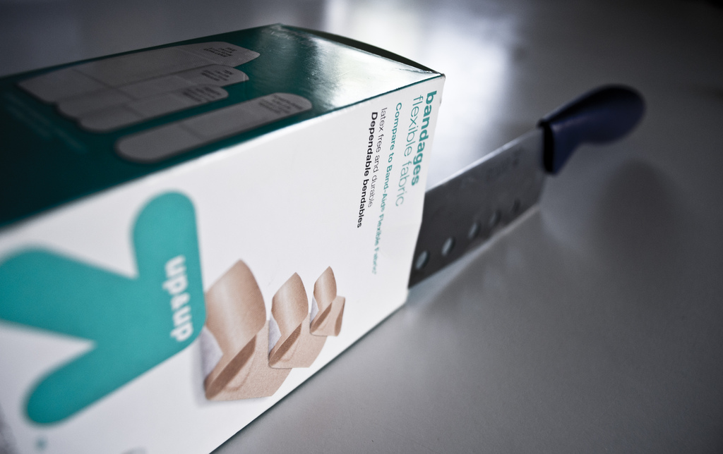
RDBMSes: Pain Points
Source: www.flickr.com/photos/spencerdahl/6075142688/

Slide 7
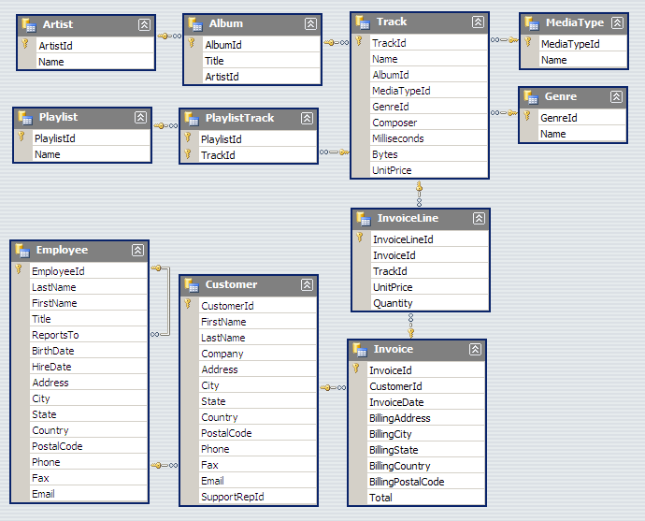
#1: Must design up front, painful to evolve

Slide 8
This should really be a list…
Consistent field names?
{
"token": 945842,
"feature_enabled": "super_special",
"userid": 229922,
"page": "null",
"info": { "email": "my@place.com" }
}
Is this really an integer?
Is this really null?
What keys? What values?
JSON to the Rescue!
Flexible design doesn’t mean no design!

Slide 9
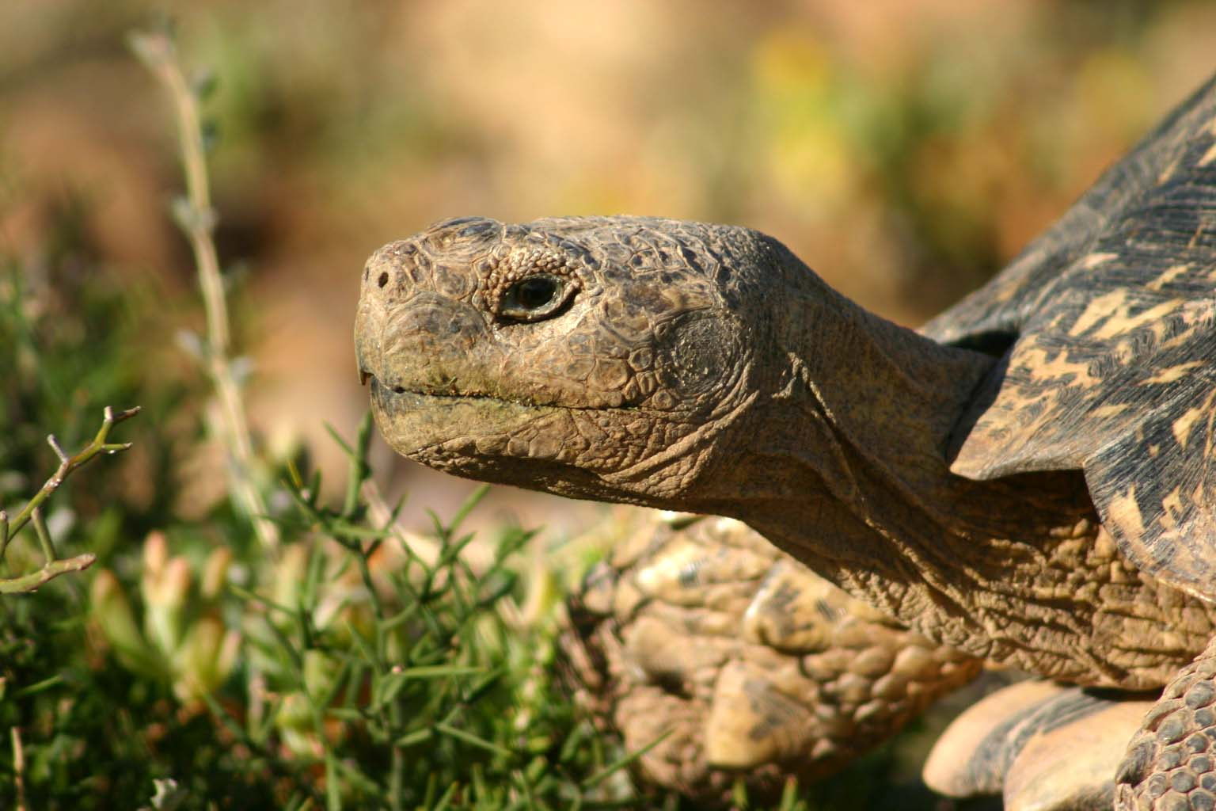
#2: Pay for ACID!
Source: Wikipedia (Tortoise)

Slide 10

#3: Cost!
Source: www.flickr.com/photos/gnusinn/3080378658/

Slide 11
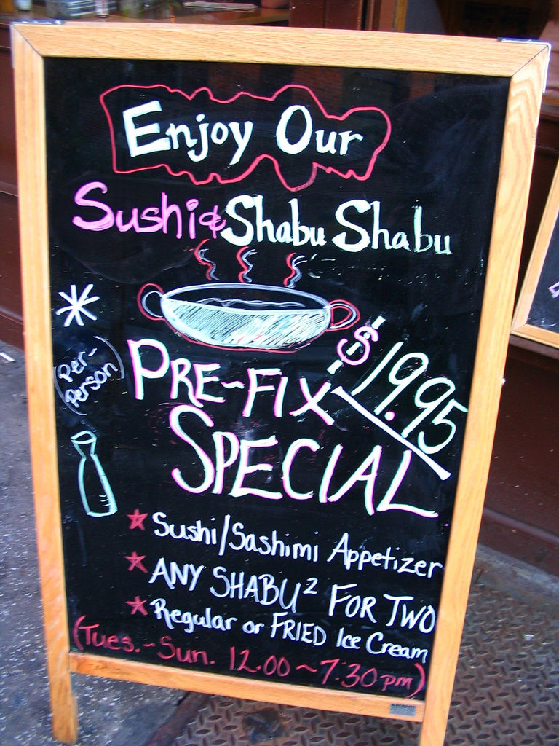
What do RDBMSes provide?
Relational model with schemas
Powerful, flexible query language
Transactional semantics: ACID
Rich ecosystem, lots of tool support
What if we want a la carte?
Source: www.flickr.com/photos/vidiot/18556565/

Slide 12
Features a la carte?
What if I’m willing to give up consistency for scalability?
What if I’m willing to give up the relational model for flexibility?
What if I just want a cheaper solution?
Enter… NoSQL!

Slide 13
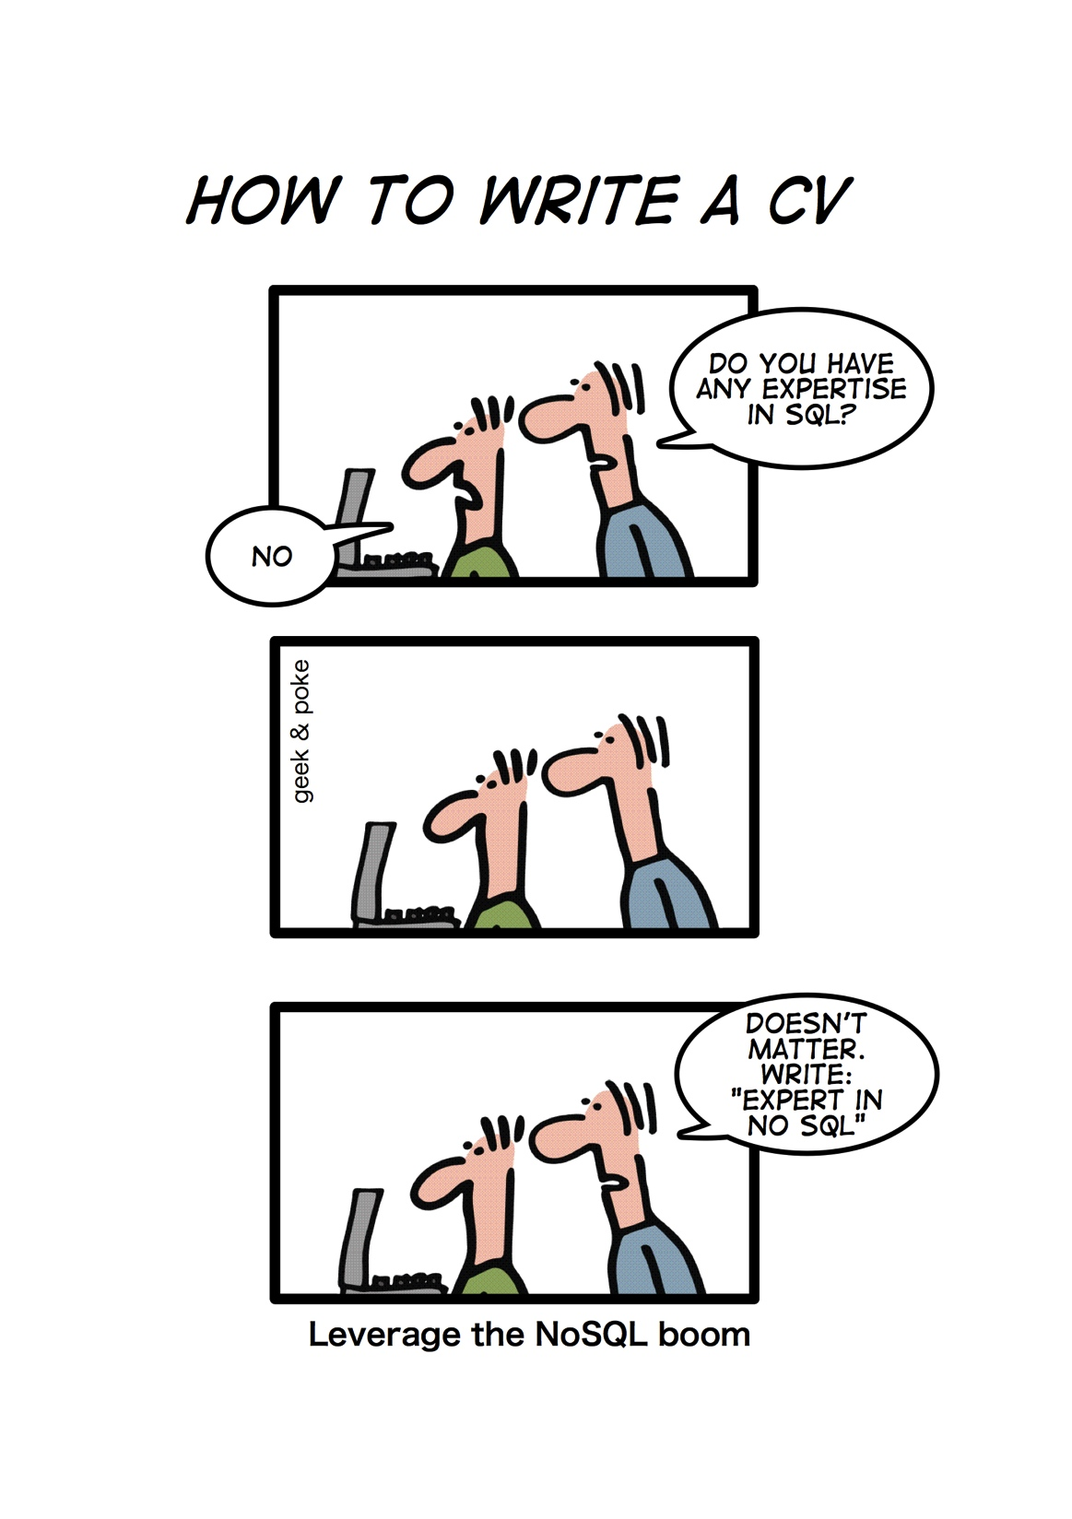
Source: geekandpoke.typepad.com/geekandpoke/2011/01/nosql.html

Slide 14
NoSQL
(Not only SQL)
Horizontally scale “simple operations”
Replicate/distribute data over many servers
Simple call interface
Weaker concurrency model than ACID
Efficient use of distributed indexes and RAM
Flexible schemas
But, don’t blindly follow the hype…
Often, MySQL is what you really need!
Source: Cattell (2010). Scalable SQL and NoSQL Data Stores. SIGMOD Record.

Slide 15

“web scale”

Slide 16
(Major) Types of NoSQL databases
Key-value stores
Column-oriented databases
Document stores
Graph databases

Slide 17
Three Core Ideas
Keeping track of the partitions?
Partitioning (sharding)
To increase scalability and to decrease latency
Consistency?
Replication
To increase robustness (availability) and to increase throughput
Consistency?
Caching
To reduce latency

Slide 18
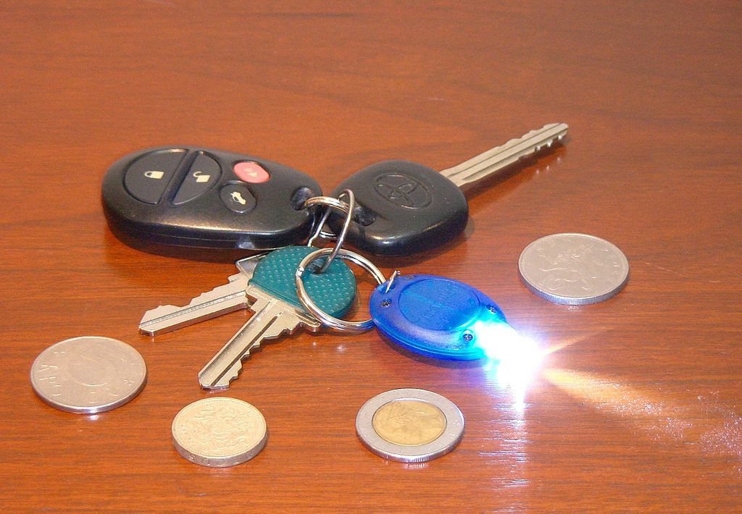
Key-Value Stores
Source: Wikipedia (Keychain)

Slide 19
Key-Value Stores: Data Model
Stores associations between keys and values
Keys are usually primitives
For example, ints, strings, raw bytes, etc.
Values can be primitive or complex: often opaque to store
Primitives: ints, strings, etc.
Complex: JSON, HTML fragments, etc.

Slide 20
Key-Value Stores: Operations
Very simple API:
Get – fetch value associated with key
Put – set value associated with key
Optional operations:
Multi-get
Multi-put
Range queries
Secondary index lookups
Consistency model:
Atomic puts (usually)
Cross-key operations: who knows?

Slide 21
Key-Value Stores: Implementation
Non-persistent:
Just a big in-memory hash table
Examples: Redis, memcached
Persistent
Wrapper around a traditional RDBMS
Examples: Voldemort
What if data doesn’t fit on a single machine?

Slide 22
Simple Solution: Partition!
Partition the key space across multiple machines
Let’s say, hash partitioning
For n machines, store key k at machine h(k) mod n
Okay… But:
How do we know which physical machine to contact?
How do we add a new machine to the cluster?
What happens if a machine fails?

Slide 23
Clever Solution
Hash the keys
Hash the machines also!
Distributed hash tables!
(following combines ideas from several sources…)

Slide 24
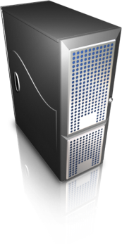
h = 2^{n} – 1
h = 0

Slide 25
h = 2^{n} – 1
h = 0
Each machine holds pointers to predecessor and successor
Send request to any node, gets routed to correct one in O(n) hops
Can we do better?
Routing: Which machine holds the key?

Slide 26
h = 2^{n} – 1
h = 0
Each machine holds pointers to predecessor and successor
+ “finger table” (+2, +4, +8, …)
Send request to any node, gets routed to correct one in O(log n) hops
Routing: Which machine holds the key?

Slide 27
h = 2^{n} – 1
h = 0
Simpler Solution
Service Registry
Routing: Which machine holds the key?

Slide 28
Stoica et al. (2001). Chord: A Scalable Peer-to-peer Lookup Service for Internet Applications. SIGCOMM.
h = 2^{n} – 1
h = 0
Cf. Gossip Protoccols
How do we rebuild the predecessor, successor, finger tables?
New machine joins: What happens?

Slide 29
h = 2^{n} – 1
h = 0
Solution: Replication
N = 3, replicate +1, –1
Covered!
Covered!
Machine fails: What happens?

Slide 30
Three Core Ideas
Keeping track of the partitions?
Partitioning (sharding)
To increase scalability and to decrease latency
Consistency?
Replication
To increase robustness (availability) and to increase throughput
Caching
To reduce latency

Slide 31
Another Refinement: Virtual Nodes
Don’t directly hash servers
Create a large number of virtual nodes, map to physical servers
Better load redistribution in event of machine failure
When new server joins, evenly shed load from other servers

Slide 32

Bigtable
Source: Wikipedia (Table)

Slide 33
Bigtable Applications
Gmail
Google’s web crawl
Google Earth
Google Analytics
Data source and data sink for MapReduce
HBase is the open-source implementation…

Slide 34
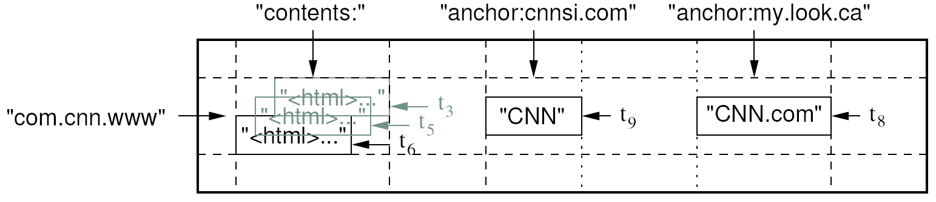
Data Model
A table in Bigtable is a sparse, distributed, persistent multidimensional sorted map
Map indexed by a row key, column key, and a timestamp
(row:string, column:string, time:int64) → uninterpreted byte array
Supports lookups, inserts, deletes
Single row transactions only
Image Source: Chang et al., OSDI 2006

Slide 35
Rows and Columns
Rows maintained in sorted lexicographic order
Applications can exploit this property for efficient row scans
Row ranges dynamically partitioned into tablets
Columns grouped into column families
Column key = family:qualifier
Column families provide locality hints
Unbounded number of columns
At the end of the day, it’s all key-value pairs!

Slide 36
Key-Values
row, column family, column qualifier, timestamp
value

Slide 37
Okay, so how do we build it?
In Memory
On Disk
Mutability Easy
Mutability Hard
Small
Big

Slide 38
Log Structured Merge Trees
MemStore
Writes
Reads
What happens when we run out of memory?

Slide 39
Log Structured Merge Trees
MemStore
Writes
Reads
Memory
Disk
Flush to disk
Store
Immutable, indexed, persistent, key-value pairs
What happens to the read path?

Slide 40
Log Structured Merge Trees
Merge
MemStore
Writes
Reads
Memory
Disk
Flush to disk
Store
Immutable, indexed, persistent, key-value pairs
What happens as more writes happen?

Slide 41
Log Structured Merge Trees
Merge
MemStore
Writes
Reads
Memory
Disk
Flush to disk
Store
Store
Store
Store
Immutable, indexed, persistent, key-value pairs
What happens to the read path?

Slide 42
Log Structured Merge Trees
Merge
MemStore
Writes
Reads
Memory
Disk
Flush to disk
Store
Store
Store
Store
Immutable, indexed, persistent, key-value pairs
What’s the next issue?

Slide 43
Log Structured Merge Trees
Merge
MemStore
Writes
Reads
Memory
Disk
Flush to disk
Store
Store
Store
Compaction!
Immutable, indexed, persistent, key-value pairs

Slide 44
Log Structured Merge Trees
Merge
MemStore
Writes
Reads
Memory
Disk
Flush to disk
Store
Compaction!
Immutable, indexed, persistent, key-value pairs

Slide 45
Log Structured Merge Trees
Merge
MemStore
Writes
Reads
Memory
Disk
Flush to disk
Logging for persistence
WAL
Store
Immutable, indexed, persistent, key-value pairs
One final component…

Slide 46
Log Structured Merge Trees
The complete picture…
Merge
MemStore
Writes
Reads
Memory
Disk
Flush to disk
Logging for persistence
WAL
Store
Store
Store
Immutable, indexed, persistent, key-value pairs
Compaction!

Slide 47
Log Structured Merge Trees
The complete picture…
Okay, now how do we build a distributed version?

Slide 48
HBase
Bigtable building blocks
HDFS
GFS
HFile
SSTable
Region
Tablet
Regions Server
Tablet Server
Chubby
Zookeeper

Slide 49
HFile
SSTable
Persistent, ordered immutable map from keys to values
Stored in GFS: replication “for free”
Supported operations:
Look up value associated with key
Iterate key/value pairs within a key range

Slide 50
Region
Tablet
Dynamically partitioned range of rows
Comprised of multiple SSTables
Tablet
aardvark - base
SSTable
SSTable
SSTable
SSTable

Slide 51
Region Server
Tablet Server
MemStore
Writes
Reads
Memory
Disk
Flush to disk
Logging for persistence
WAL
SSTable
SSTable
SSTable
Immutable, indexed, persistent, key-value pairs
Compaction!

Slide 52
Table
Comprised of multiple tablets
SSTables can be shared between tablets
Tablet
aardvark - base
Tablet
basic - database
SSTable
SSTable
SSTable
SSTable
SSTable
SSTable

Slide 53
Region
Region Server
Tablet to Tablet Server Assignment
Each tablet is assigned to one tablet server at a time
Exclusively handles read and write requests to that tablet
What happens when a tablet grow too big?
What happens when a tablet server fails?
We need a lock service!

Slide 54
HBase
Bigtable building blocks
HDFS
GFS
HFile
SSTable
Region
Tablet
Regions Server
Tablet Server
Chubby
Zookeeper

Slide 55
Architecture
Client library
HMaster
Bigtable master
Tablet servers
Regions Servers

Slide 56
Bigtable Master
Roles and responsibilities:
Assigns tablets to tablet servers
Detects addition and removal of tablet servers
Balances tablet server load
Handles garbage collection
Handles schema changes
Tablet structure changes:
Table creation/deletion (master initiated)
Tablet merging (master initiated)
Tablet splitting (tablet server initiated)

Slide 57
Compactions
Minor compaction
Converts the memtable into an SSTable
Reduces memory usage and log traffic on restart
Merging compaction
Reads a few SSTables and the memtable, and writes out a new SSTable
Reduces number of SSTables
Major compaction
Merging compaction that results in only one SSTable
No deletion records, only live data

Slide 58
Table
Comprised of multiple tables
SSTables can be shared between tablets
Tablet
aardvark - base
Tablet
basic - database
How does this happen?
SSTable
SSTable
SSTable
SSTable
SSTable
SSTable

Slide 59
Three Core Ideas
Keeping track of the partitions?
Partitioning (sharding)
To increase scalability and to decrease latency
Consistency?
Replication
To increase robustness (availability) and to increase throughput
Caching
To reduce latency

Slide 60
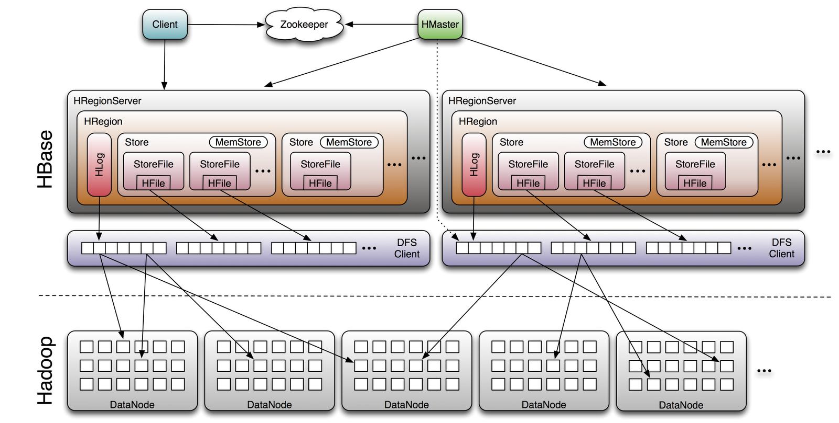
HBase
Image Source: http://www.larsgeorge.com/2009/10/hbase-architecture-101-storage.html

Slide 61

Questions?
Source: Wikipedia (Japanese rock garden)

